Slide 1
Personalized Restaurant Recommendation System – Yelp
Your personal local restaurant recommendation

Slide 2
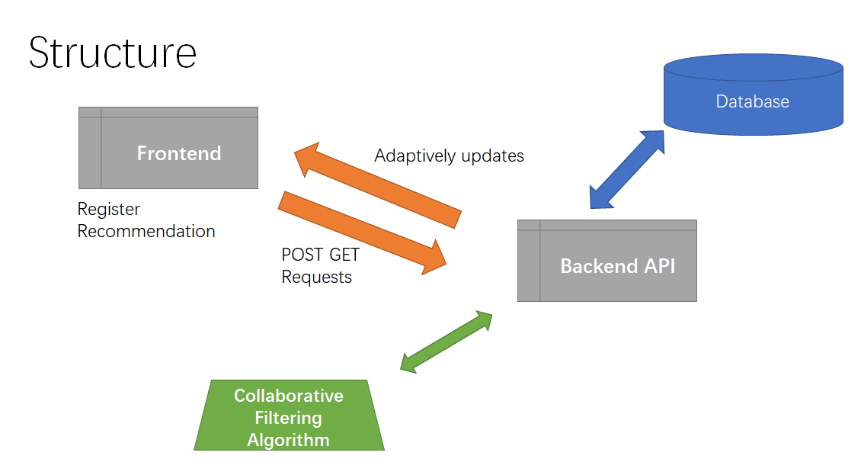
Search
Notes:
The fontend has 3 different

Slide 3

A User’s Path
Users sign-up
Give stars to listed restaurant for CF
Selected preferable key words
update user_profile database
update reviews database
Adaptive recommendation
Adaptive search

Slide 4
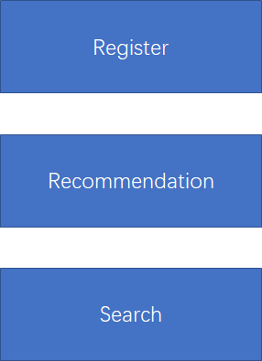
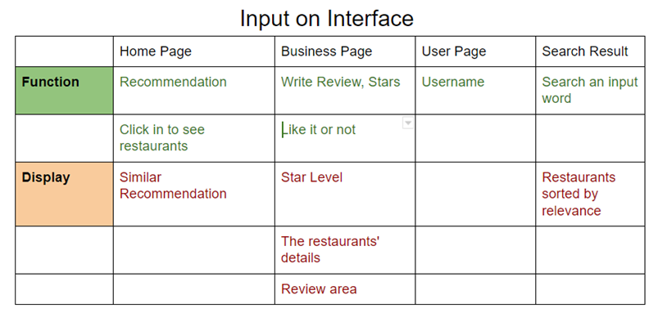
User Interface

Slide 5
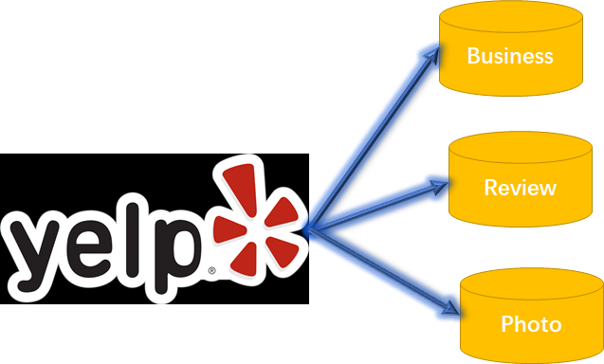



Data and Environment
We only used business in Pittsburgh

Slide 6
Database
Whole database
Business: 188,593
Reviews: 5,996,996
Distributed Database by location : Pittsburgh
Business_pitt: 6804
Review_pitt : 201,679
Users: 62,806
Categories(tags): 879
transfer

Slide 7
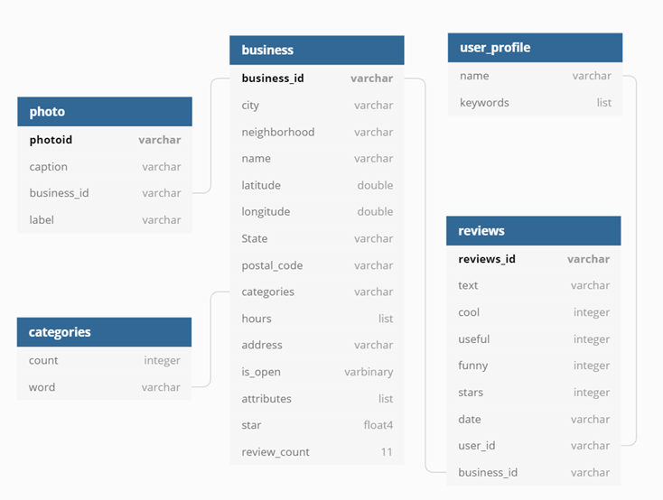
Database
reviews
photos
businesses<aggregative: review count, stars>
user_profile
categories <aggregative: count>

Slide 8
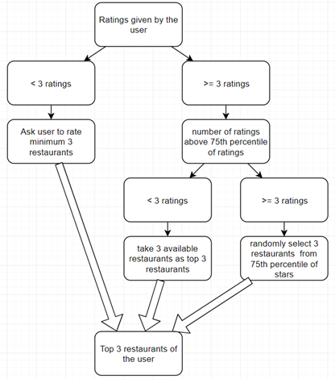
Algorithm
Personalized
Recommendation

Slide 9
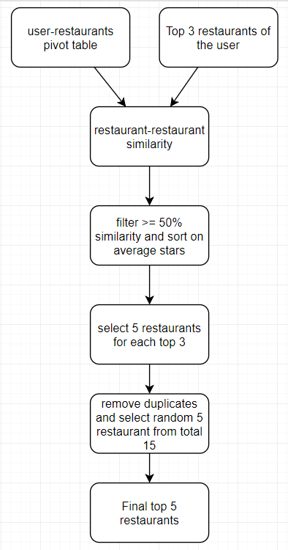
Item-Item
Collaborative Filtering

Slide 10
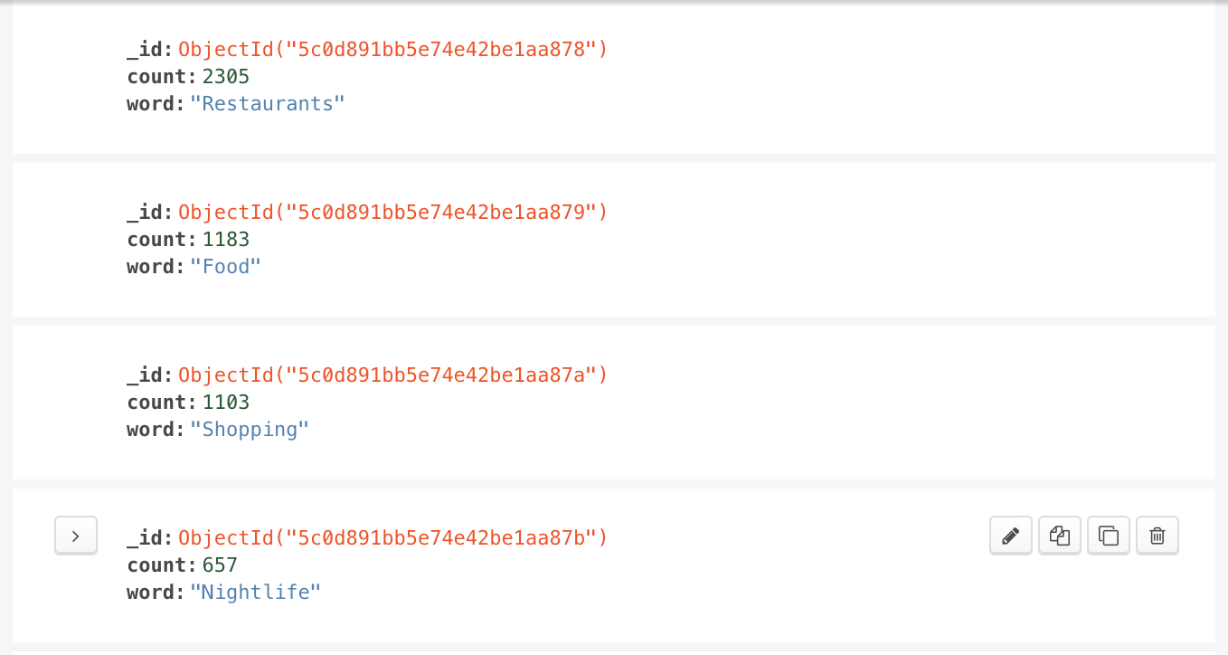
Algorithm
Category table
Word :String
Frequency: Int
Frequency is how many times this category word appear in business

Slide 11
Algorithm
Adaptive Search Based on Keywords Vectors(20 words)
old
new
category1 | category2 | category2
Drop
Add
By Frequency
0<= categories < 200 (33%) | 200 <= categories <= 700(66%) | categories > 700(100%)

